Slide 1
cyberbullying
RAMLAC
ARRON,ADAM,GABRIELA, WILLIAM, ANTONIO AND INES

Slide 2
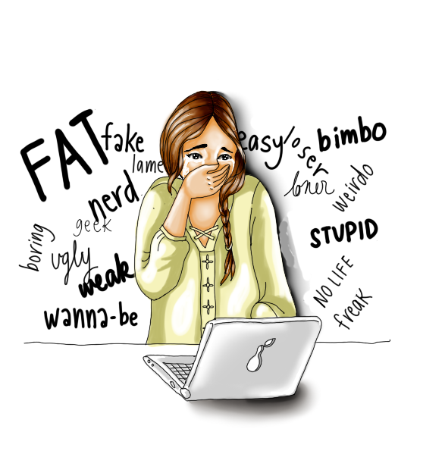
definition
Act
Harming or harassing
Via information technology networks
Repeated and deliberate manner

Slide 3
WhaT IS CYBER-Bullying?
Cyberbullying is the use of technology to harass, threaten, embarrass, or target another person. By definition, it occurs among young people. When an adult is involved, it may meet the definition of cyber-harassment or cyberstalking, a crime that can have legal consequences and involve jail time.

Slide 4
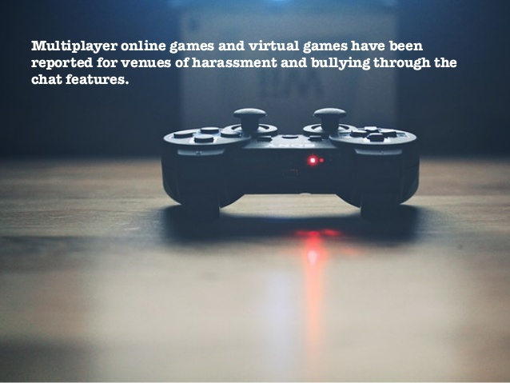
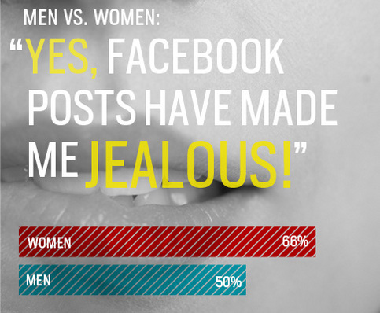
Methods used
Social media
Gaming
Jealousy
Facebook, Myspace, and Twitter
Video game culture
Pictures and Posts

Slide 5
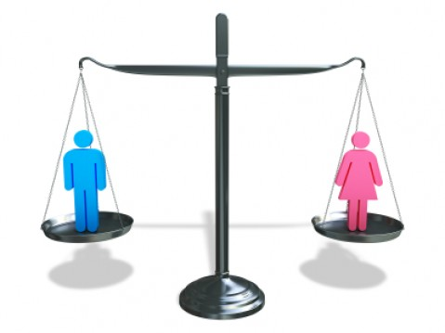
Methods used
Body image
Equality
Popularity
Weight is a huge concern
Don’t discriminate against
Number of likes +
followers

Slide 6
Solutions to overcome this:
Talk about it
Tell an adult
Delete application
Block sender
Therapy
Get it off your mind
Talk to family
Make the authority aware
Counseling

