Slide 1
ESTONIA
GABRIELA CEA
MAIALEN CASADO

Slide 2
MAIALEN

Slide 3
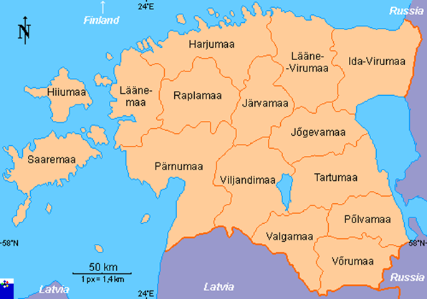
ABOUT ESTONIA
Estonia is the most northerly of the three Baltic States and is a predominantly flat country on the eastern shores of the Baltic Sea. Estonia’s main export partners are Sweden, Finland and Latvia, while its main import partners are Finland, Germany and Sweden.

Slide 4
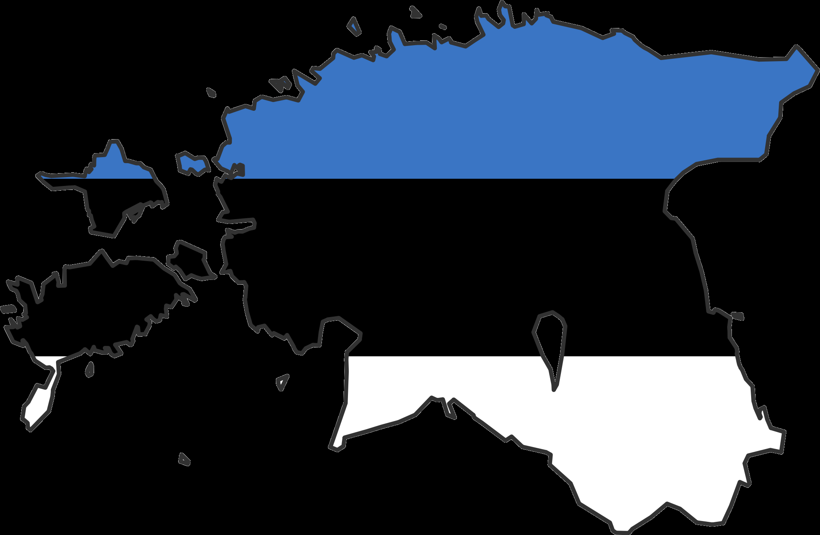
Capital: Tallinn
Geographical size: 45 227 km2
Population: 1 315 819 (2014)
Population as % of total EU population: 0.3 % (2014)
Official EU language: Estonian
Political system: parliamentary republic
EU member country since: 01-05-2004
Seats in the European Parliament: 6
Currency: Euro. Member of the eurozone since 01-01-2011

Slide 5
When did this country join to the Eurepean Union?
In 2003 Estonian European Union membership referendum took place on 14th September of 2003 to decide whether Estonia should join the European Union (EU). Just over two-thirds of voters voted Yes and Estonia joined the EU on 01-05-2004.

Slide 6
FLAG OF ESTONIA
Estonia has three colours:
BLUE FOR THE SKY
THE COLOR BLACK SOIL
WHITE SYMBOLIZES THE JOY OF THE PEOPLE

Slide 7
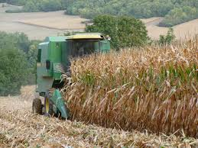
PRIMARY SECTOR
The primary sector in Estonia is the agriculture, the fishing, livestock and mining.
Agriculture 5.9%
Meat, fish, potatoes export, fruits, vegetables.

Slide 8
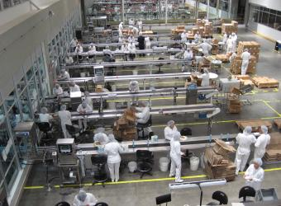
SECONDARY SECTOR
The secondary sector in Estonia is the building and the industry.
Production: shipyards phosphates, electric motors, cement, excavators, shoes, clothes, textiles…
Industry 29.2%

Slide 9
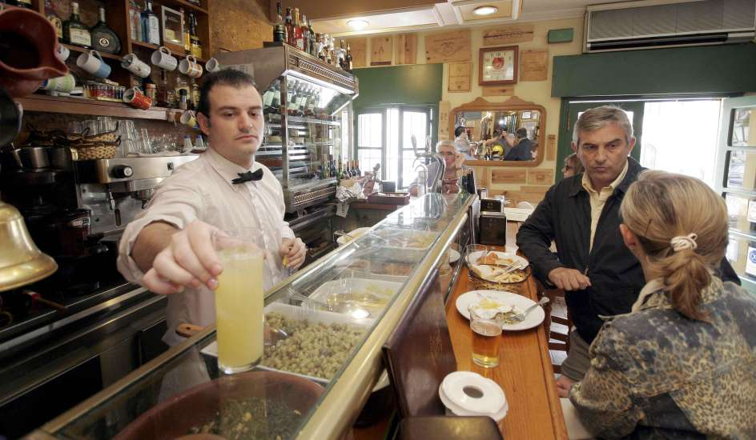
TERTIARY SECTOR
This sector is the sector of services for example the turism, transport and trade.
Services:64.9%

Slide 10
CLIMATE OF ESTONIA
Estonia lies in the northern part of the temperate climate zone and in the transition zone between maritime and continental climate. The average temperature in July, which is considered the warmest month of the year, is 20.5°C.
Spring is usually dry and mild. It can still snow in April and May. May is the warmest month in spring when first heat waves arrive.
Summers are mild warmest in south and east Estonia, colder on the islands. Some days temperatures can reach up 18-20°C, but usually its near 20°C
Autumn is wet and windy. First half of September can be warm. Many cyclones cross Scandinavia and brings strong storms and rains to Estonia.
It is coldest in East of Estonia and warmest on the coastal areas. Coldest month is January and February (some nights low can be -35°C)

Slide 11
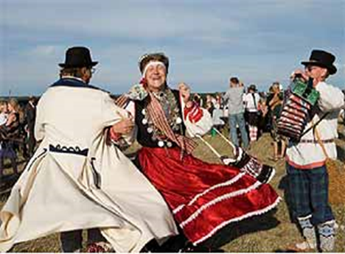
MUSIC
Throughout the centuries, music and singing have played an essential role in the survival of Estonian national feeling. The tradition of choral festivals, which began during the national awareness movement of the nineteenth century, it remains one of the most characteristic phenomena of Estonian cultural life.

Slide 12
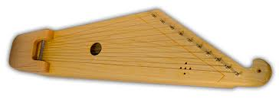
KANNEL
Is an instrument of Estonia it is believed to have been around for two thousands years. Such an instrument in common to cultures of Baltic Finnis, the balts and the northwestern Russians.

Slide 13
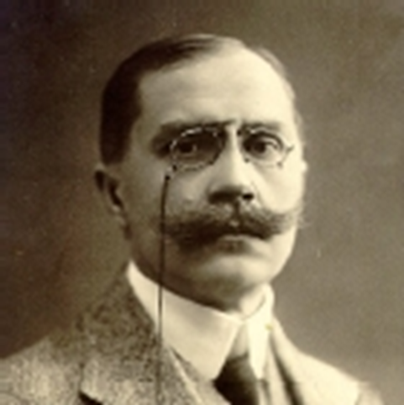
LITERATURE
Under the influence of the Protestant tradition, Estonian culture has focused more on the word in the image, even putting literature to other art forms.
Erik Schmidt Karro

Slide 14
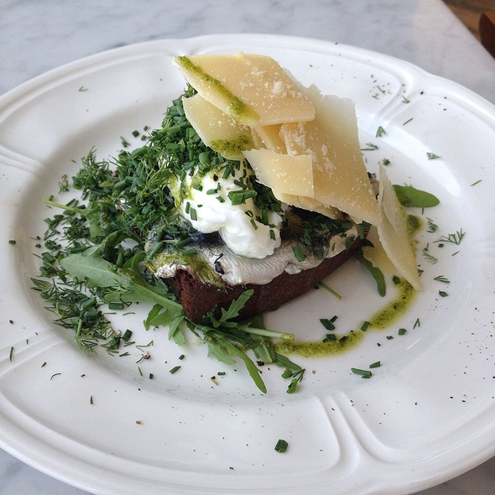
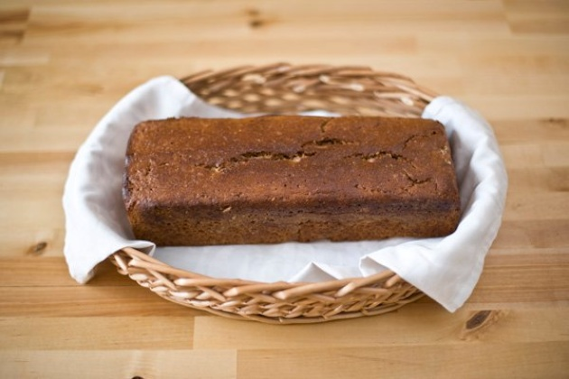
FOOD
Traditional Estonian cuisine has substantially been based on potatoes, on fish in coastal and lakeside areas, but now bears influence from many other cuisines, including a variety of international foods and dishes, with a number of contributions from the traditions of nearby countries: German and Russia.
Sprat Sandwich Homemade Bread

Slide 15
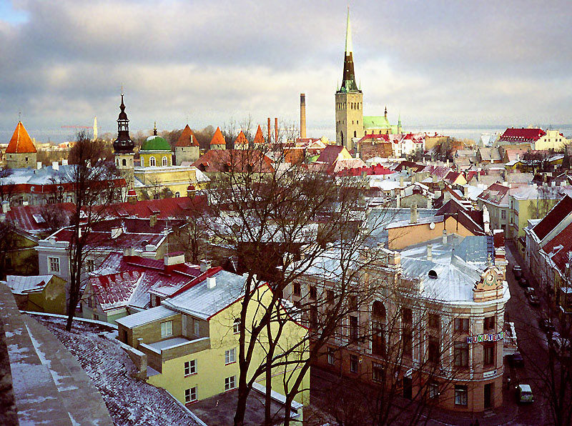
PLACES TO VISIT
TALLINN: Is the capital of Estonia, wich is known for the medieval like estructure. It’s also the oldest city of Estonia.

Slide 16
VIDEO OF TALLIN
https://www.youtube.com/watch?v=8O4PEtjvaXE

Slide 17
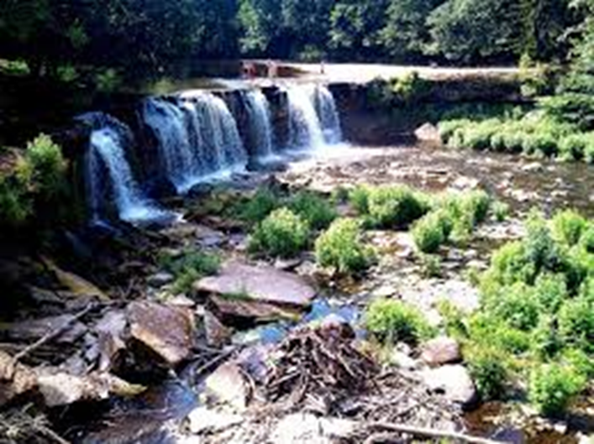
Is a waterfall located in the north of Estonia.The third most powerful waterfall in Estonia after Narva and Jala.

Slide 18
KADRIORG PALACE
This place was built by peter the first from his empress. It is used now as a summer park. This palace is located in the north of the country.

Slide 19
BIBLIOGRAPHY/SOURCES
http://es.slideshare.net/antoniocasmo/estonia-7890495
http://europa.eu/about-eu/countries/member-countries/estonia/index_en.htm
http://europa.eu/about-eu/countries/member-countries/estonia/index_en.htm
http://europa.eu/about-eu/countries/member-countries/estonia/index_en.htm

Slide 20
THE END. THANK YOU

