Slide 1
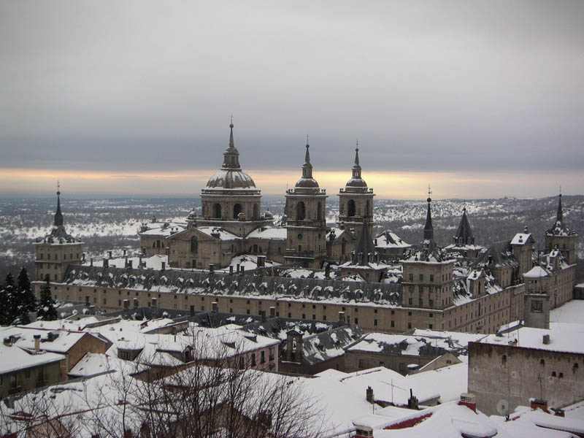
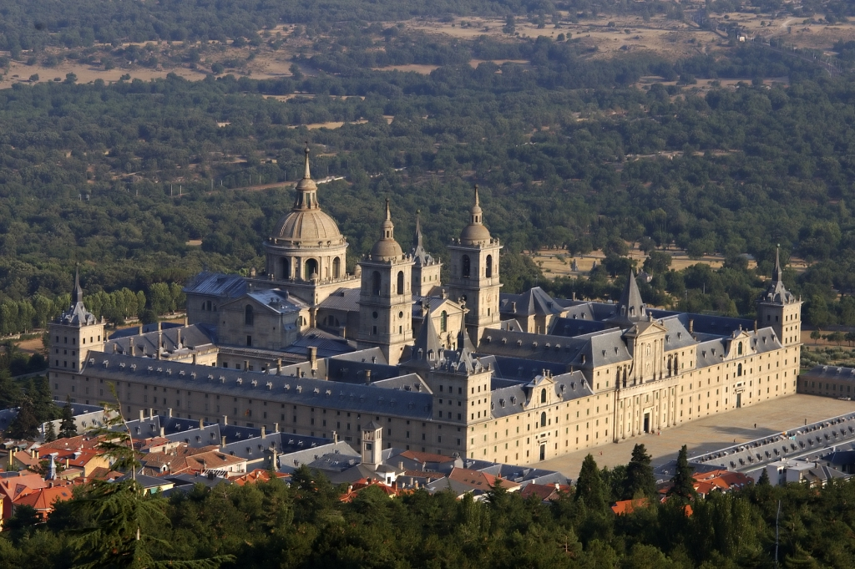
Monastery of San Lorenzo de El Escorial
Gabriela Cea

Slide 2
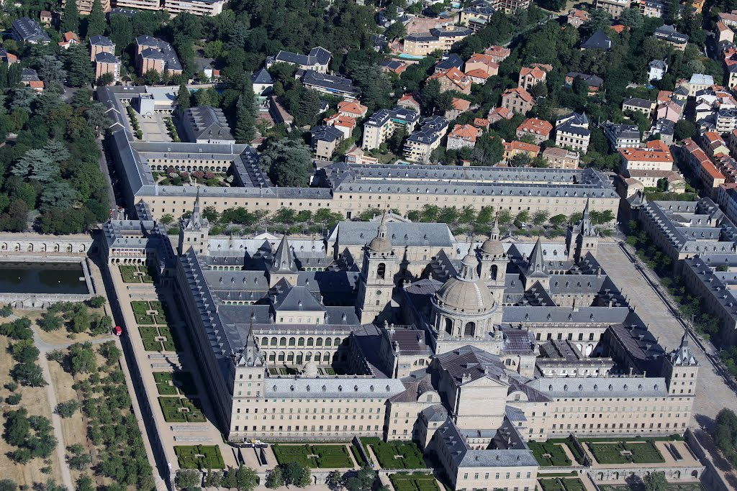
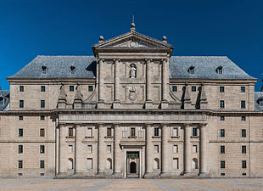
The views
By plane
In front
In one side
If you want to see all the rooms in the house, you have to travel 18 kilometers.

Slide 3
What is it?
It is a complex that includes a royal palace, a basilica, a cemetery, a library and a monastery. It is located in the town of San Lorenzo de El Escorial in Madrid, Spain, and was built between 1563 and 1584.
The exorbitant price of building the Monastery, "the eighth wonder of the world" The most conservative estimates placed the figure at 6.5 million ducats, over revenues of Castilla for a year.
The cost gold today of the monastery equivalent to more than 585 million euros.
How much cost?

Slide 4
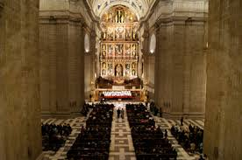
How long it takes to build?
Felipe II achieved the most striking visual feature of the building, uniformity
He promoted the creation of a dozen large buildings throughout Spain.
After 21 years, the works officially ended in September 1584 with the opening of the basilica, although they were extended for ten years in other rooms, so it took 35 years to complete the building.
Juan de Herrera was the designer and is built with granite stone

Slide 5
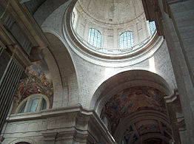
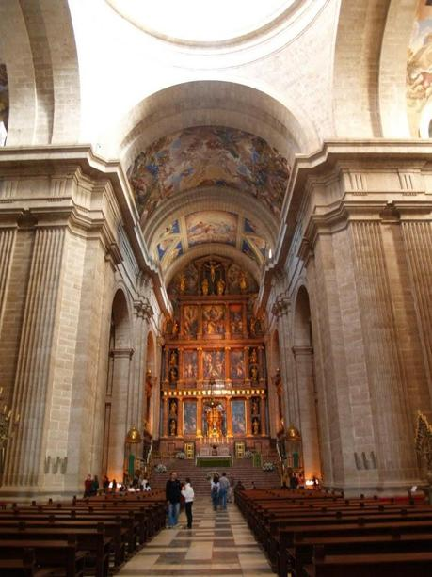
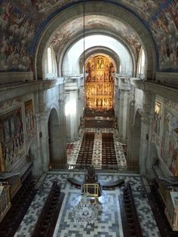
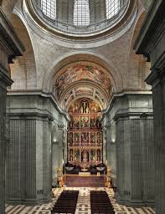
Inside the basilica

