Slide 1
OUR WORK EXPERIENCE
Gabriela Cea and Maialen Casado

Slide 2
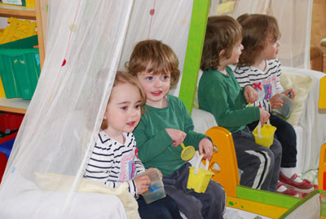
WHAT WAS ABOUT?
The work experince was looking after children in a Creche (Montessori, Waterside, Malahide).
We looked after children between 2-4 years old.

Slide 3
The Creche
We had to wear something pink, such a T-shirt or a jumper and black trousers or jeans.
Time | Monday | Tuesday | Wednesday | Thursday | Friday
9:00-10:00 | FREE TIME | FREE TIME | FREE TIME | FREE TIME | FREE TIME
10:00-11:00 | SNACK | SNACK | SNACK | SNACK | SNACK
11:00-12:00 | CIRCOL TIME | CIRCOL TIME | CIRCOL TIME | CIRCOL TIME | CIRCOL TIME
12:00-13:00 | LUNCH | LUNCH | LUNCH | LUNCH | LUNCH
13:00-14:00 | SLEEP TIME | SLEEP TIME | SLEEP TIME | SLEEP TIME | SLEEP TIME
14:00-15:00 | READING | READING | READING | READING | READING

Slide 4
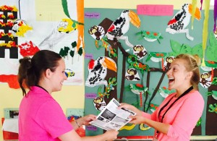
Relationships in the creche
The manager was very kind with us, she helped us a lot and we are very grateful for that, because the first day was not easy.The first day was not easy cause we didn't know the children and how they work, but the teacher help us to involve in the creche.

Slide 5
THANK YOU FOR LISTENING

