Slide 1
THALES
Marina carmona
And gabriela cea

Slide 2
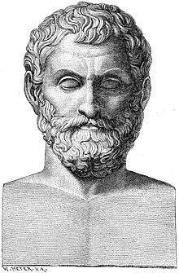
Thales of miletus
He was a pre-Socratic Greek philosopher, mathematician and astronomer from Miletus in Asia Minor, he was born in a.C 624 and he died in a.C 546.
Many, most notably Aristotle, regard him as the first philosopher in the Greek tradition. Aristotle reported Thales' hypothesis that the originating principle of nature and the nature of matter was a single material substance: water.

Slide 3
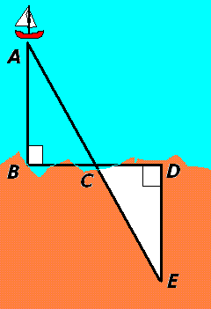
In mathematics...
In mathematics, Thales used geometry to calculate the heights of pyramids and the distance of ships from the shore. He is the first known individual to use deductive reasoning applied to geometry, by deriving four corollaries to Thales' Theorem. He is the first known individual to whom a mathematical discovery has been attributed

Slide 4
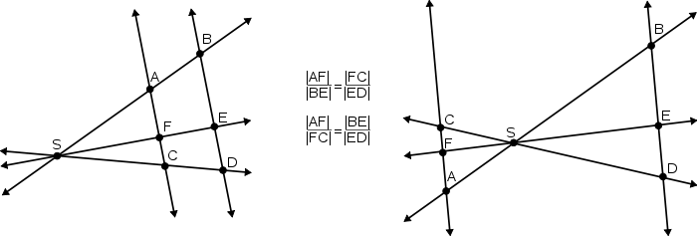
Theorems
Thales’ theorem
BD/AD = CE/AE.
Intercept theorem

Slide 5
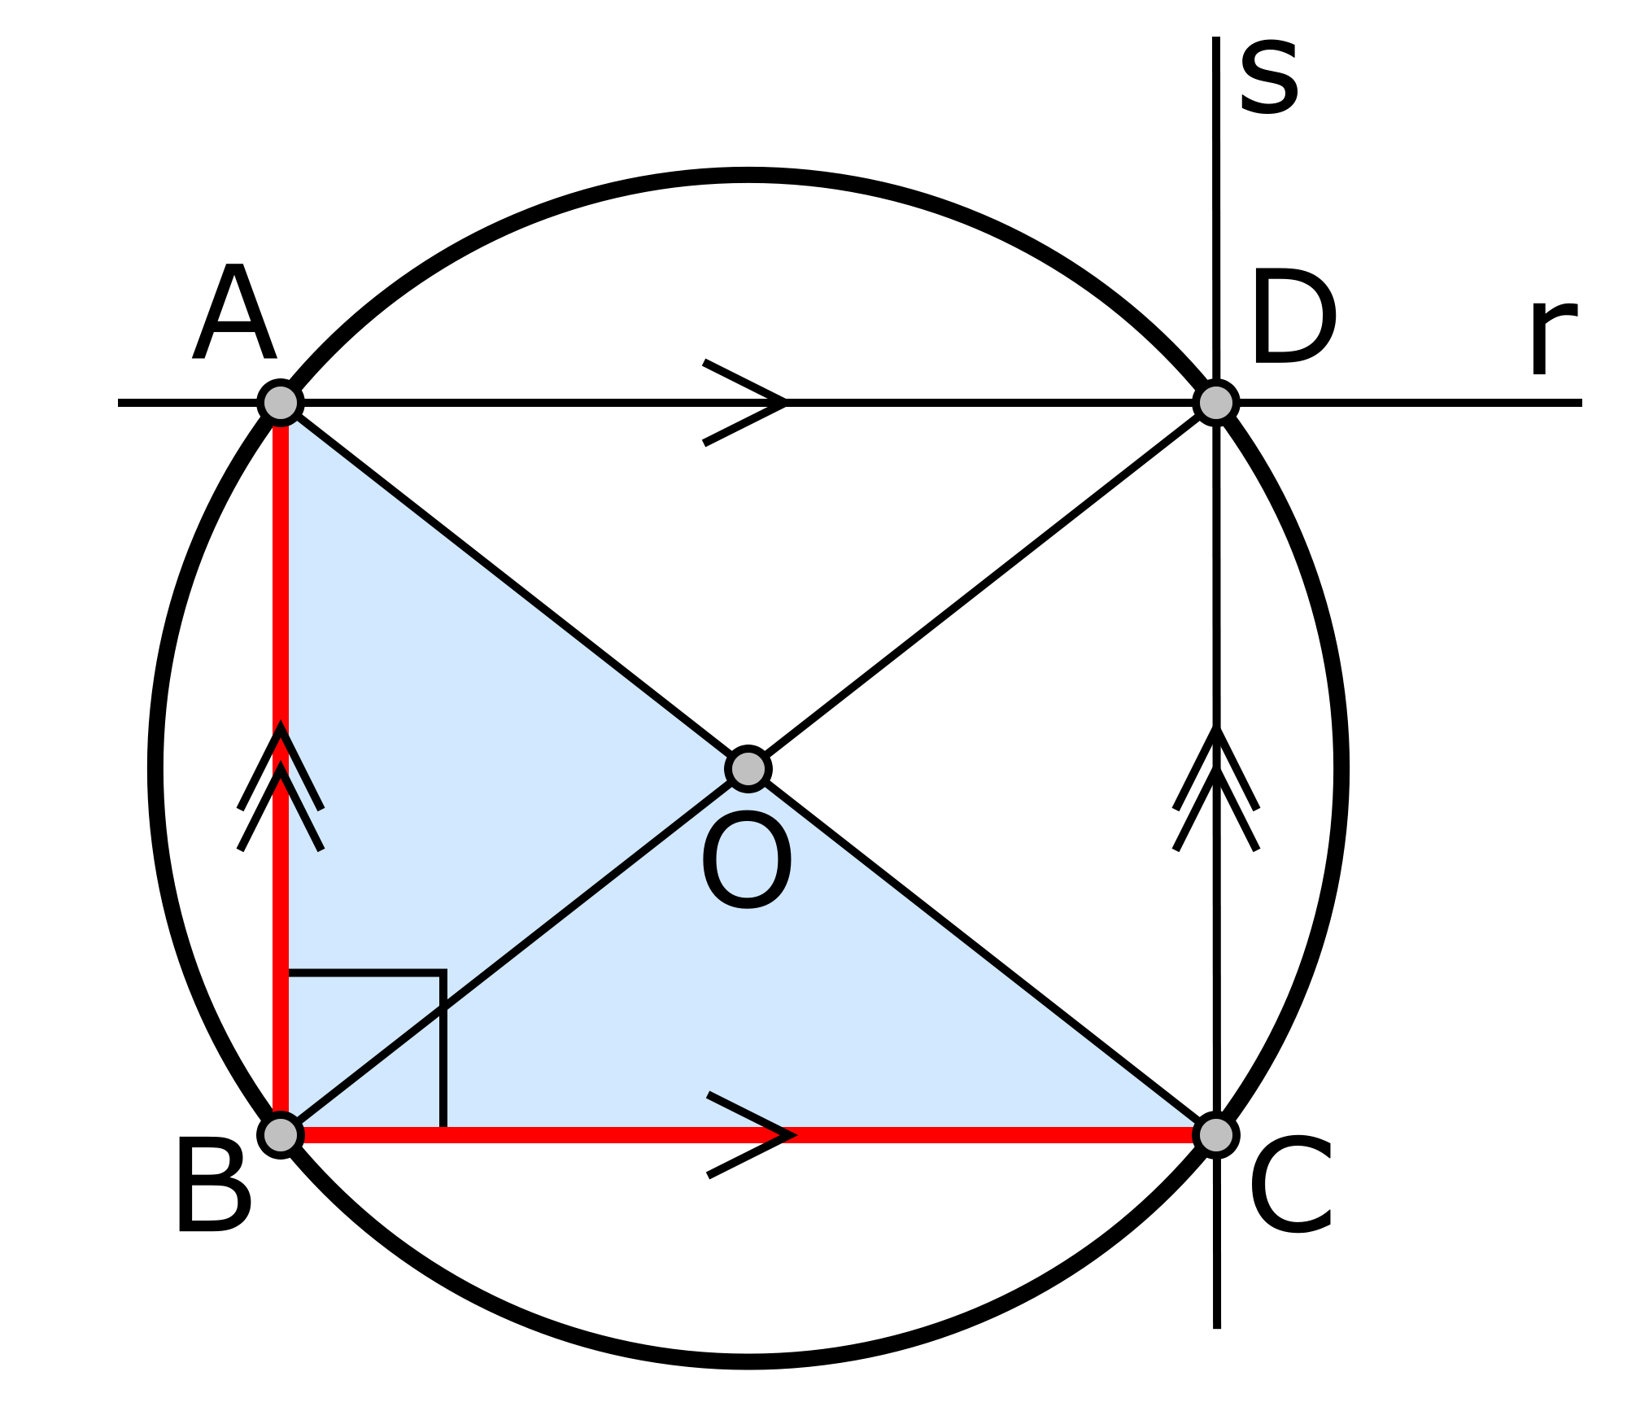
THALES' THEOREM
First proof:
The following facts are used: the sum of the angles in a triangle is equal to 180° and the base angles of an isosceles triangle are equal.
Provided AC is a diameter, angle at B is constant right(90°).

Slide 6
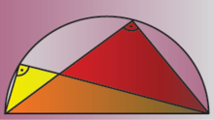
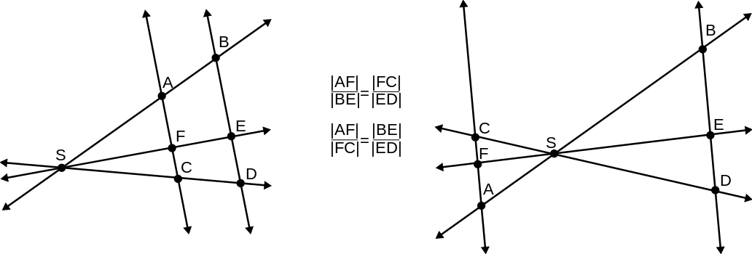
Intercept theorem
The intercept theorem, also known as Thales' theorem, is an important theorem in elementary geometry about the ratios of various line segments that are created if two intersecting lines are intercepted by a pair of parallels. It is equivalent to the theorem about ratios in similar triangles.

Slide 7
The second theorem of Thales is a theorem of geometry particularly focused on right triangles, circumferences and inscribed angles.

Slide 8
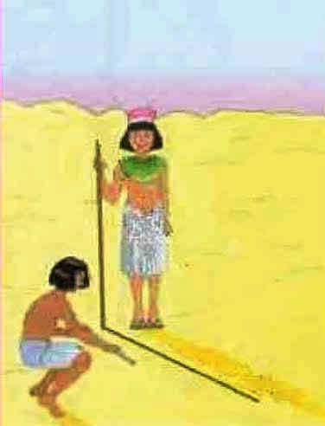
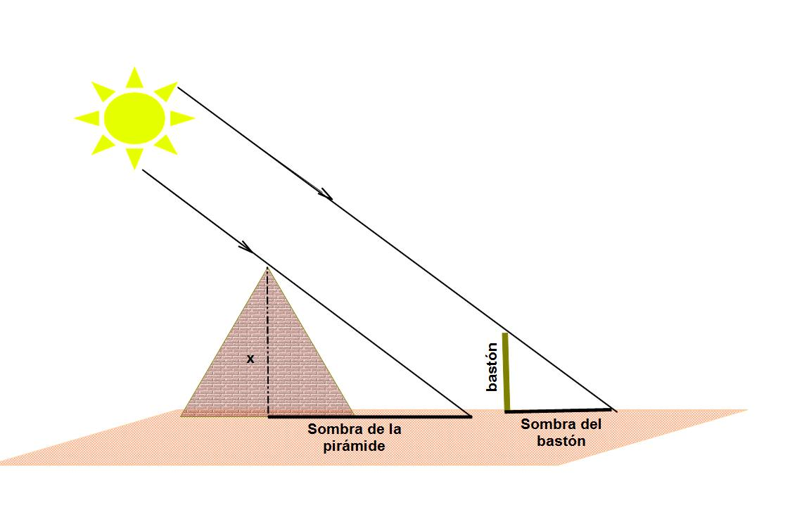
MATHEMATICAL CONTRIBUTIONS
It is attributed to such other findings recorder in mathematics Euclid's Elements
It is also well known legend about a comparison method shadows that Thales would have used to measure the height of the Egyptian pyramids: by measuring the shadow of these at the time the day his shadow was roughly the same size as your body.

Slide 9
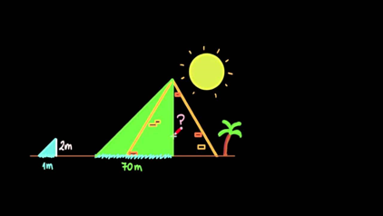
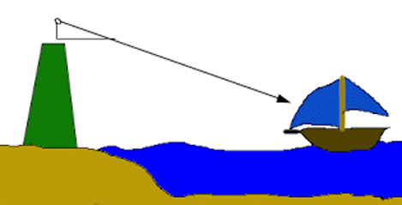
THALES THEOREM IN REAL LIFE

Slide 10
Thanks for watching!

