Slide 1
THE FIRST QUEEN OF SPAIN
GABRIELA CEA USERA

Slide 2
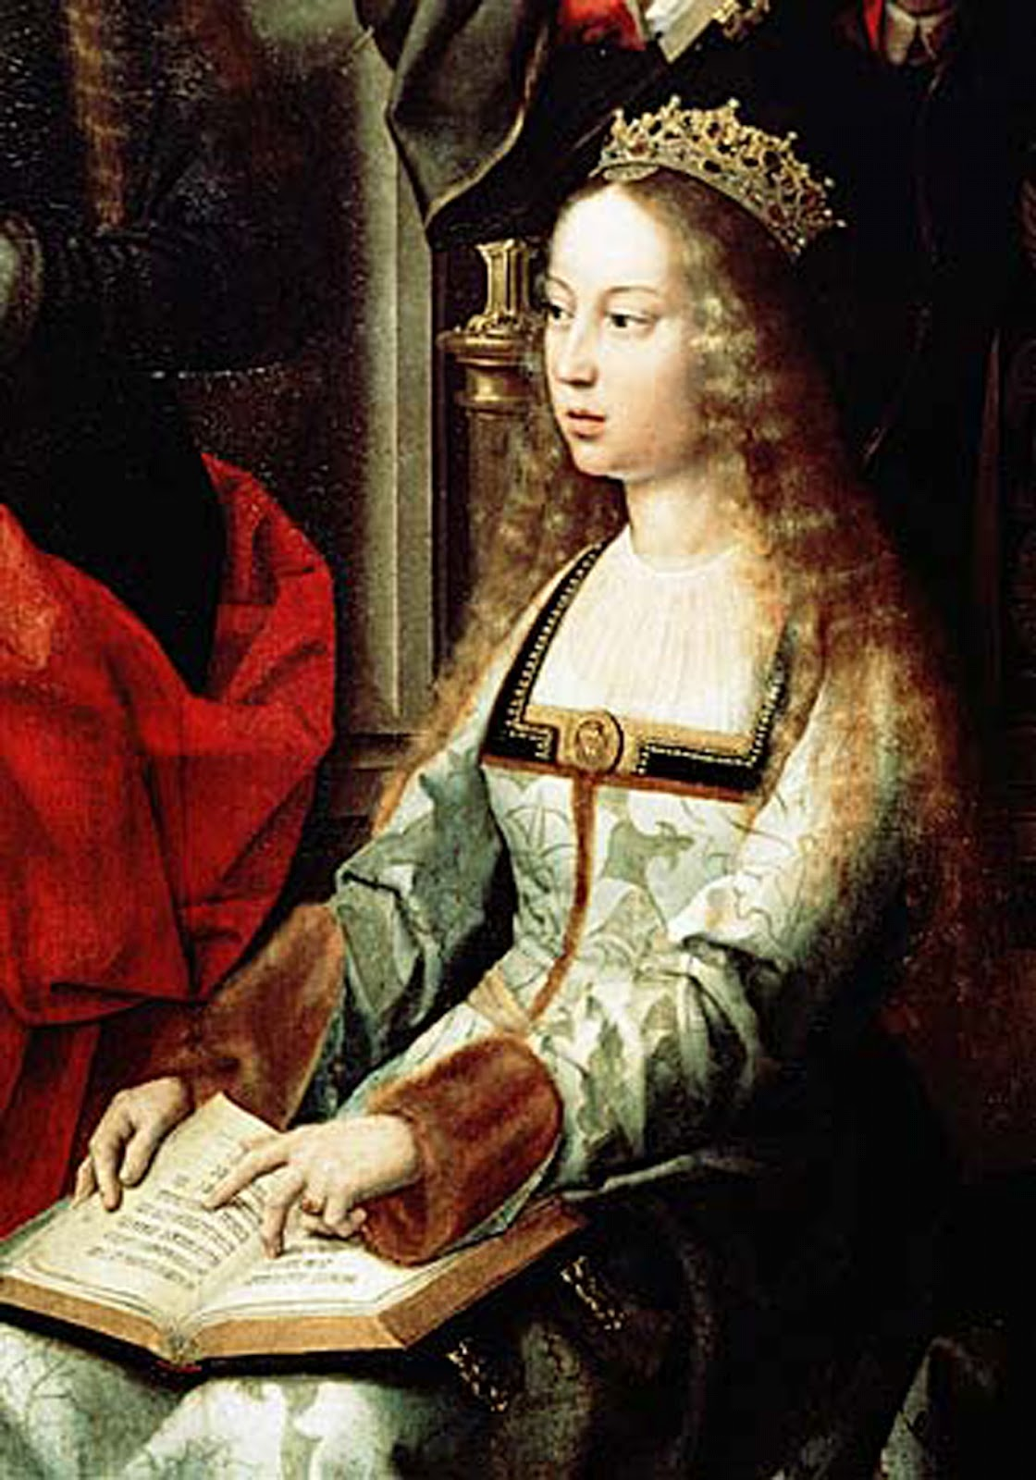
ISABEL I
Isabel la catolica; was queen of Castilla from 1474-1504 , by marriage to Fernando of Aragon . It is called "Catholic", a title that was given to her and her husband by Pope Alexander VI by the Bull If convenient on 19 December 1496. It is therefore known to the royal couple by the name of Fernando and Isabel , title henceforth they would use virtually all the kings of Spain .

Slide 3
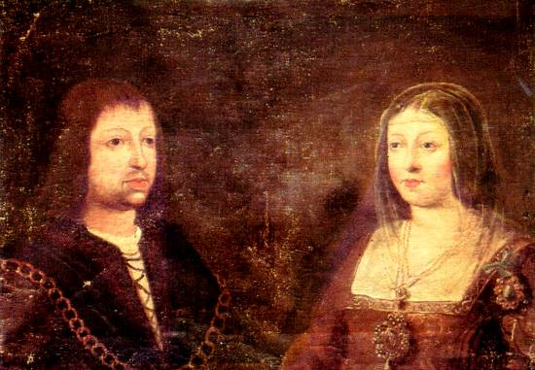
HER LIFE
She married in 1469 to Prince Fernando of Aragon.
Isabel and Fernando seized the throne after a long struggle, first against King Enrique IV and 1475-1479 in the War of the Castilian Succession against supporters of the other pretender to throne, Juana.

Slide 4
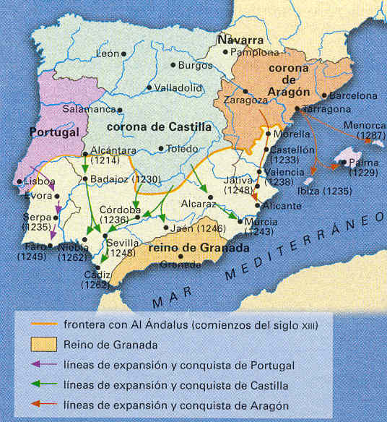
ACHIEVEMENTS
She and her husband Fernando conquered the Moorish kingdom of Granada and part of one of the red marriage alliances that made his grandson, Carlos, inherit the crowns of Castile and Aragon, other European territories and were to become Emperor of the Holy Roman Empire.

Slide 5
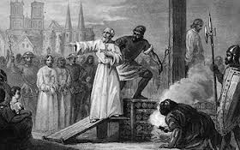
THE SPANISH INQUISITION
After winning the War of Granada Fernando and Isabel expelled the Jews from their kingdoms six years and, years later, also Muslims.
The Spanish Inquisition or the Holy Office of the Inquisition was an institution founded in 1478 by Fernando and Isabel to maintain Catholic orthodoxy in their kingdoms.

Slide 6
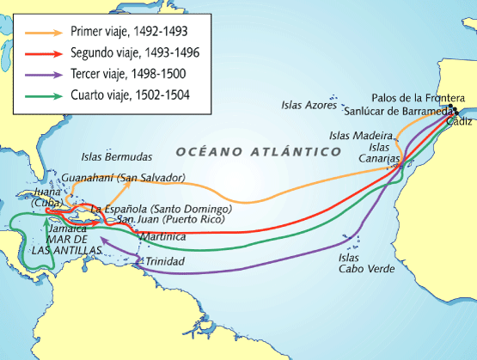
DISCOVERY OF AMERICA
Isabel gave support to Christopher Columbus in search of the West Indies, which led to the discovery of America. That event would result in the conquest of the lands discovered and the creation of the Spanish Empire.

Slide 7
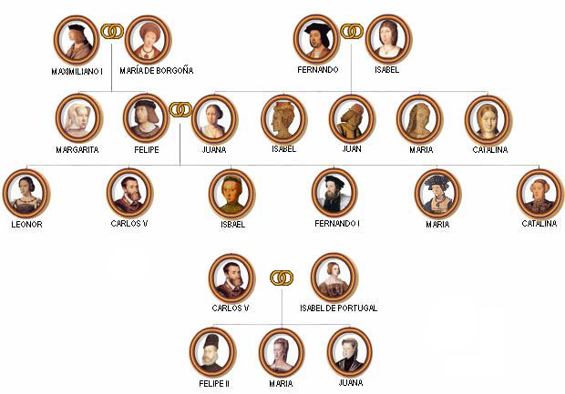
FAMILY TREE
Isabel lived 53 years , of which 30 years he ruled as queen of Castile and 26 as Queen Consort of Aragon next to Fernando II .

Slide 8
Why This event is elected ?
Because it was an era of conquest, in which America was discovered and Isabel was the first woman Queen of Spain. It’s my favorite time of history and the last year I wached a series on the queen and her dynasty.
Where do I found the information ?
I found the information in my history book last year, in my parents’s history books and on the “Isabel” and on this sources:
www.historia-espana.com/LaReconquistaEspanola.aspx
www.elhistoriador.com.ar/aula/medieval/reconquista_espanola.php
all these sources have helped me, unlike wikipedia, because I didn’t found what I wanted.

